Slide 1
Understanding Previous Year Code
Detailed Understanding Of Previous year Project Code

Slide 2
Module EXT Count

Slide 3
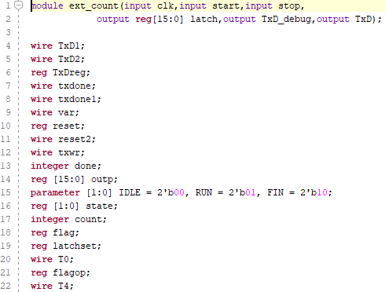
Initial Declaration
All declarations for the code is done here (for module ext_count)
Here the parameter in line 15 describes the states of the FSM.

Slide 4
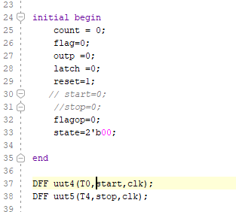
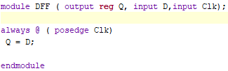
Intitialization and DFF module
The initial begin block initializes the data.
It also sets the starting state of the FSM to the Idle state (2’b00)
The DFF module is called for setting the values to T0 and T4 based on the FPGA clock.

Slide 5
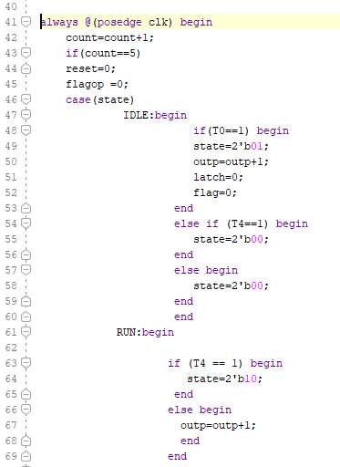
Main Code
The code is run for each positive edge in clock
The flagop reg is used to store if the count value in the outp register is stored in the latch or not.
The case IDLE sets the state of the FSM to RUN if the state is IDLE and sets it to IDLE if not.
T0 and T4 denotes the start and stop signals respectively synchronized with the FPGA clock.

Slide 6
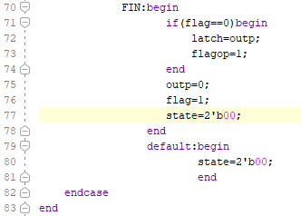
Main Code (Contd.)
Once the FSM reached the FIN state the flag is set to 1 so that the output is not assigned in the output latch again.
The state of the FSM is initialized again to 00(IDLE).

Slide 7
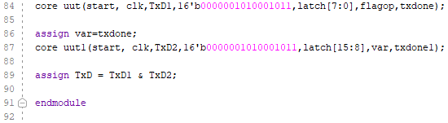
The core.v module is used to send the output to the FPGA display.
The flagop is used to provide a start operation for the core module.
The core uut1 is only done if the txdone feedback is received from the core uut when the transmission is done
The TxD id used to find that both the modules have done their transmission to the display

Slide 8
Parts not Understood

Slide 9
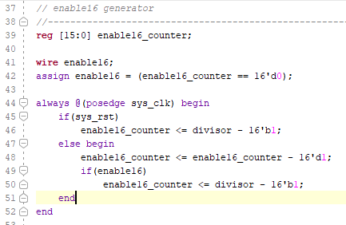
In core.v
Unable to understand the use of enable16_counter in the module
Not understood how the value of divisor is used.

